Slide 1
Prescription label reading
Detailed project report (DPR)
Mary Ara N.

Slide 2
objective
To build a text-to-voice system that will create voice messages from the prescription label. This voice message can then be sent to the patient’s phone. Enabling voice messages can make it easier for elderly people to understand the doctor’s message. Here are the benefits of this solution:
• Text-to-voice can provide peace of mind by empowering the doctor to give better services. For example, you could even send voice messages that read prescription labels.
• For the patient, a talking label sent straight to his device makes it easy to know everything about his medication. Dosage info can also be tracked and shared with caregivers.

Slide 3
Problem statement
People, like the elderly and visually impaired, with reading difficulties find it difficult to accurately read and get the right dosage and other information from their prescription labels. Supporting elderly or vulnerable patients should be a focus for any business in the health care sector.

Slide 4
approach
apply OCR techniques to extract the text data from the prescriptions and convert them into speech.

Slide 5
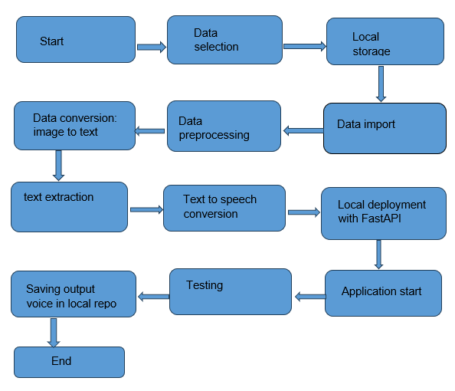
Architecture

Slide 6
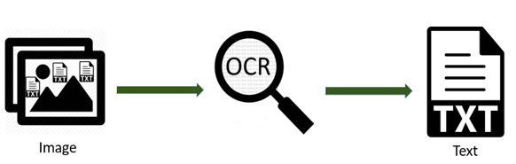
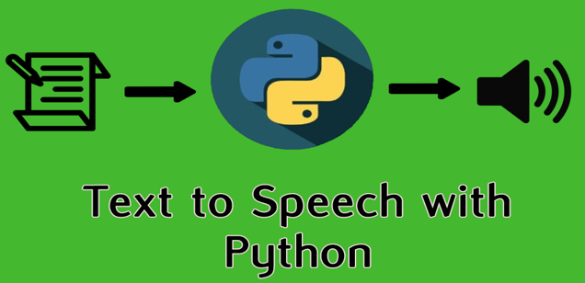
Data flow

Slide 7
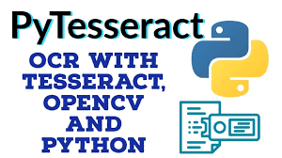

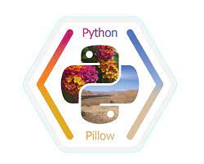
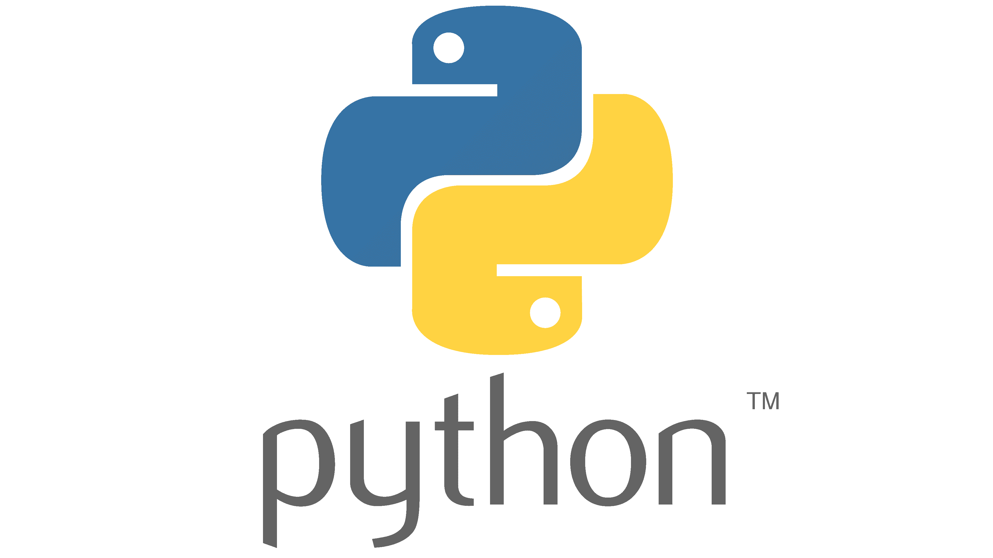
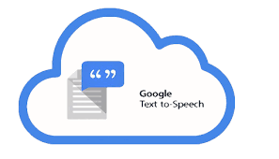

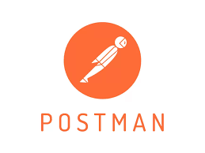
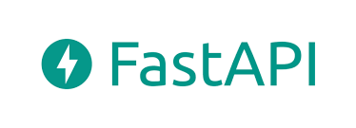


Tools used

Slide 8
process
Step 1: upload an image.
Step 2: Preprocesses image
Step 3: Extracts Text from pre-processed image.
Step 4: Text recognition is performed by OCR.
Step 5: Relevant text is extracted using Regex.
Sep 6: Text is converted to speech and stored in local repository a .MP3 file.

Slide 9
conclusion
The prescription label reading image-to-speech app will make life easier for the aging and vulnerable, by helping them get the right dosage of their prescriptions without having to read.

Slide 10
Thank you

